Slide 1
Unit-6 Computer Hardware

Slide 2
Different components of computer
Already discussed
Power supply
A power supply is an electrical device that supplies electric power to an electrical load. The primary function of a power supply is to convert electric current from a source to the correct voltage, current, and frequency to power the load. As a result, power supplies are sometimes referred to as electric power converters. Some power supplies are separate standalone pieces of equipment, while others are built into the load appliances that they power. Examples of the latter include power supplies found in desktop computers and consumer electronics devices. Other functions that power supplies may perform include limiting the current drawn by the load to safe levels, shutting off the current in the event of an electrical fault, power conditioning to prevent electronic noise or voltage surges on the input from reaching the load, power-factor correction, and storing energy so it can continue to power the load in the event of a temporary interruption in the source power (uninterruptible power supply).

Slide 3
Types of power supply
DC power supply
A DC power supply is one that supplies a constant DC voltage to its load. Depending on its design, a DC power supply may be powered from a DC source or from an AC source such as the power mains.

Slide 4
Contd.
AC-to-DC supply
Schematic of basic AC-to-DC power supply, showing (from L-R) transformer, full-wave bridge rectifier, filter capacitor and resistor load
DC power supplies use AC mains electricity as an energy source. Such power supplies will employ a transformer to convert the input voltage to a higher or lower AC voltage. A rectifier is used to convert the transformer output voltage to a varying DC voltage, which in turn is passed through an electronic filter to convert it to an unregulated DC voltage.
The filter removes most, but not all of the AC voltage variations; the remaining AC voltage is known as ripple. The electric load's tolerance of ripple dictates the minimum amount of filtering that must be provided by a power supply. In some applications, high ripple is tolerated and therefore no filtering is required. For example, in some battery charging applications it is possible to implement a mains-powered DC power supply with nothing more than a transformer and a single rectifier diode, with a resistor in series with the output to limit charging current.

Slide 5
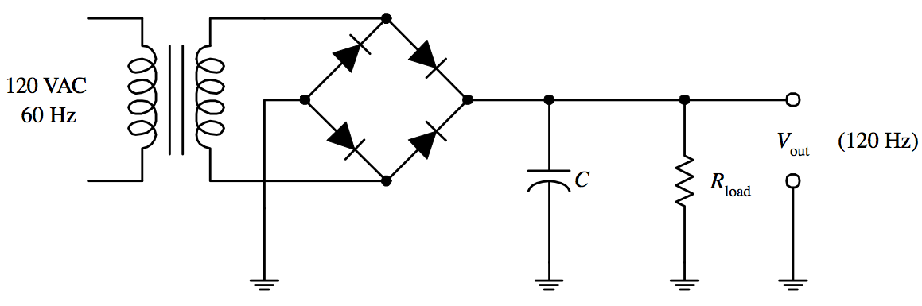
contd.. Block diagram
Schematic of basic AC-to-DC power supply, showing (from L-R) transformer, full-wave bridge rectifier, filter capacitor and resistor load

Slide 6
Contd…
An AC power supply typically takes the voltage from a wall outlet (mains supply) and uses a transformer to step up or step down the voltage to the desired voltage. Some filtering may take place as well. In some cases, the source voltage is the same as the output voltage; this is called an isolation transformer. Other AC power supply transformers do not provide mains isolation; these are called autotransformers; a variable output autotransformer is known as a variac. Other kinds of AC power supplies are designed to provide a nearly constant current, and output voltage may vary depending on impedance of the load. In cases when the power source is direct current, (like an automobile storage battery), an inverter and step-up transformer may be used to convert it to AC power. Portable AC power may be provided by an alternator powered by a diesel or gasoline engine (for example, at a construction site, in an automobile or boat, or backup power generation for emergency services) whose current is passed to a regulator circuit to provide a constant voltage at the output. Some kinds of AC power conversion do not use a transformer. If the output voltage and input voltage are the same, and primary purpose of the device is to filter AC power, it may be called a line conditioner. If the device is designed to provide backup power, it may be called an uninterruptable power supply. A circuit may be designed with a voltage multiplier topology to directly step-up AC power; formerly, such an application was a vacuum tube AC/DC receiver.

Slide 7
Ratings
A rating is the evaluation or assessment of something, in terms of quality (as with a critic rating a novel), quantity (as with an athlete being rated by his or her statistics), or some combination of both.
Rating may also refer to:
Credit rating, estimating the credit worthiness of an individual, corporation or country
Fire-resistance rating, the duration for a passive fire protection to withstand a standard fire resistance test
Naval rating, an enlisted member of a country's Navy not conferred by commission or warrant
Health care provider ratings
Performance Rating, in computing, used by AMD
Ranally city rating, a tool used to classify U.S. cities based on economic function
Power rating, defined as the highest power input allowed to flow through particular equipment
Content rating, like the following:
Web content voting, a system where users rate Web content
Rating site, website that allows rating
Reputation system, a score for a set of objects within the community based on a collection of opinions
Telecommunications rating, the calculated cost of a phone call
United States presidential approval rating, a polling term which reflects the approval of the President of the United States.

Slide 8
SMPS
A switched-mode power supply (switching-mode power supply, switch-mode power supply, switched power supply, SMPS, or switcher) is an electronic power supply that incorporates a switching regulator to convert electrical power efficiently. Like other power supplies, an SMPS transfers power from a DC or AC source (often mains power) to DC loads, such as a personal computer, while converting voltage and current characteristics. Unlike a linear power supply, the pass transistor of a switching-mode supply continually switches between low-dissipation, full-on and full-off states, and spends very little time in the high dissipation transitions, which minimizes wasted energy. Ideally, a switched-mode power supply dissipates no power. Voltage regulation is achieved by varying the ratio of on-to-off time. In contrast, a linear power supply regulates the output voltage by continually dissipating power in the pass transistor. This higher power conversion efficiency is an important advantage of a switched-mode power supply. Switched-mode power supplies may also be substantially smaller and lighter than a linear supply due to the smaller transformer size and weight.

Slide 9
UPS
An uninterruptible power supply, also an uninterruptible power source, UPS or battery/flywheel backup, is an electrical apparatus that provides emergency power to a load when the input power source or mains power fails. A UPS differs from an auxiliary or emergency power system or standby generator in that it will provide near-instantaneous protection from input power interruptions, by supplying energy stored in batteries, supercapacitors, or flywheels. The on-battery runtime of most uninterruptible power sources is relatively short (only a few minutes) but sufficient to start a standby power source or properly shut down the protected equipment.
A UPS is typically used to protect hardware such as computers, data centers, telecommunication equipment or other electrical equipment where an unexpected power disruption could cause injuries, fatalities, serious business disruption or data loss. UPS units range in size from units designed to protect a single computer without a video monitor (around 200 volt-ampere rating) to large units powering entire data centers or buildings. The world's largest UPS, the 46-mega watt Battery Electric Storage System (BESS), in Fairbanks, Alaska, powers the entire city and nearby rural communities during outages.

Slide 10
Motherboard
A motherboard (sometimes alternatively known as the mainboard, system board, baseboard, planar board or logic board,^{[1]} or colloquially, a mobo) is the main printed circuit board (PCB) found in general purpose microcomputers and other expandable systems. It holds and allows communication between many of the crucial electronic components of a system, such as the central processing unit (CPU) and memory, and provides connectors for other peripherals. Unlike a backplane, a motherboard usually contains significant sub-systems such as the central processor, the chipset's input/output and memory controllers, interface connectors, and other components integrated for general purpose use.
Motherboard specifically refers to a PCB with expansion capability and as the name suggests, this board is often referred to as the "mother" of all components attached to it, which often include peripherals, interface cards, and daughtercards: sound cards, video cards, network cards, hard drives, or other forms of persistent storage; TV tuner cards, cards providing extra USB or FireWire slots and a variety of other custom components.

Slide 11
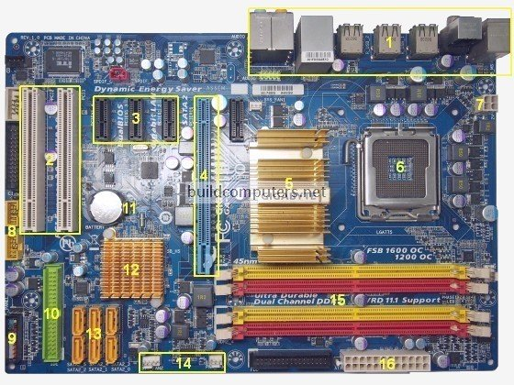
Motherboard diagram

Slide 12
Components of motherboard
1. Back Panel Connectors & Ports Connectors and ports for connecting the computer to external devices such as display ports, audio ports, USB ports, Ethernet ports, PS/2 ports etc. See image below for a close-up view. For details on the individual back panel ports, click here for our guide to computer cable connections.
2. PCI Slots PCI: Peripheral Component Interconnect Slot for older expansion cards such as sound cards, network cards, connector cards. See image below for a close-up view.

Slide 13
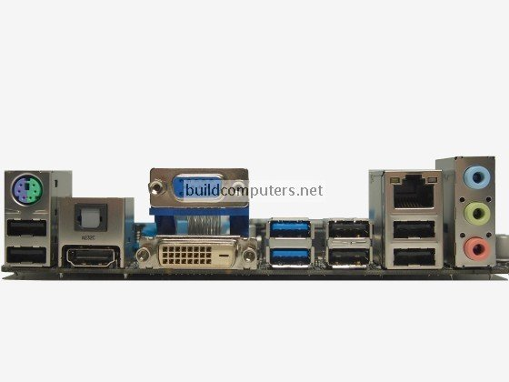

Slide 14
3. PCI Express x1 Slots
Slot for modern expansion cards such as sound cards, network cards (Wi-Fi, Ethernet, Bluetooth), connector cards (USB, FireWire, e SATA) and certain low-end graphics cards. See image below for a close-up view.
4. PCI Express x16 Slot
Slot for discrete graphic cards and high bandwidth devices such as top-end solid state drives. See image below for a close-up view.

Slide 15
Contd..
5. North bridge
Also known as Memory Controller Hub (MCH). Chipset that allows the CPU to communicate with the RAM and graphics card. Beginning from Intel Sandy Bridge in 2011, this motherboard component is no longer present as it has been integrated within the CPU itself.
6. CPU Socket
Insert CPU here. To learn how to install a CPU, click here for our guide to installing a CPU.
7. ATX 12V Power Connector
Connects to the 4-pin power cable of a power supply unit which supplies power to the CPU.

Slide 16
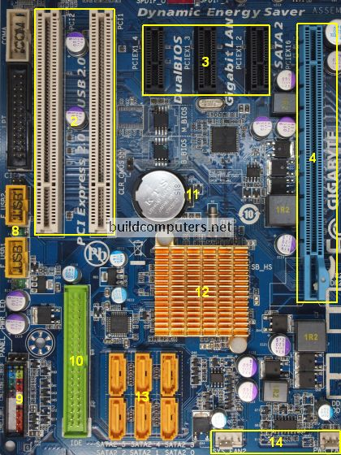

Slide 17
System chipset
In a computer system, a chipset is a set of electronic components in an integrated circuit that manages the data flow between the processor, memory and peripherals. It is usually found on the motherboard. Chipsets are usually designed to work with a specific family of microprocessors. Because it controls communications between the processor and external devices, the chipset plays a crucial role in determining system performance.

Slide 18
Contd.
In computing, the term chipset commonly refers to a set of specialized chips on a computer's motherboard or an expansion card. In personal computers, the first chipset for the IBM PC AT of 1984 was the NEAT chipset developed by Chips and Technologies for the Intel 80286 CPU.
Diagram of Commodore Amiga's Original Chip Set
A part of an IBM T42 laptop motherboard. CPU: Central processing unit. NB: Northbridge. GPU: Graphics processing unit. SB: Southbridge.
In home computers, game consoles and arcade-game hardware of the 1980s and 1990s, the term chipset was used for the custom audio and graphics chips. Examples include the Commodore Amiga's Original Chip Set or SEGA's System 16 chipset.

Slide 19
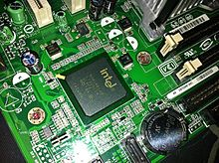
Contd.
Intel ICH7 Southbridge on Intel D945GCPE Desktop Board

Slide 20
System bus
A system bus is a single computer bus that connects the major components of a computer system, combining the functions of a data bus to carry information, an address bus to determine where it should be sent, and a control bus to determine its operation. The technique was developed to reduce costs and improve modularity, and although popular in the 1970s and 1980s, more modern computers use a variety of separate buses adapted to more specific needs.

Slide 21
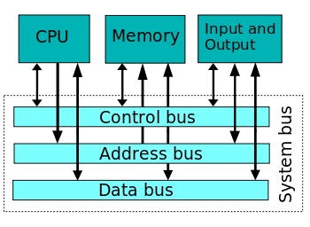
Example of a single system computer bus

Slide 22
System Bios
For IBM PC compatible computers, BIOS( an acronym for Basic Input/output System and also known as the System BIOS, ROM BIOS or PC BIOS) is non-volatile firmware used to perform hardware initialization during the booting process (power-on startup), and to provide runtime services for operating systems and programs.^{[1]} The BIOS firmware comes pre-installed on a personal computer's system board, and it is the first software run when powered on. The name originates from the Basic Input/output System used in the CP/M operating system in 1975.Originally proprietary to the IBM PC, the BIOS has been reverse engineered by companies looking to create compatible systems. The interface of that original system serves as a de facto standard.

Slide 23
Contd.
The BIOS in modern PCs initializes and tests the system hardware components, and loads a boot loader or an operating system from a mass memory device. In the era of MS-DOS, the BIOS provided a hardware abstraction layer for the keyboard, display, and other input/output (I/O) devices that standardized an interface to application programs and the operating system. More recent operating systems do not use the BIOS after loading, instead accessing the hardware components directly.

Slide 24
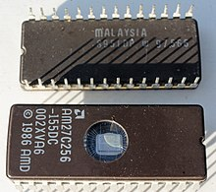
BIOS DIAGRAM
A pair of AMD BIOS chips for a Dell310 computer from the late 1980s

Slide 25
Computer Processor Types
Budget processors
AMD Sempron
Intel Celeron
Mainstream processors
AMD Athlon 64
Intel Pentium 4
Dual-core processors
AMD Athlon 64 X2
Intel Pentium D
AMD and Intel processor summaries

